Slide 1
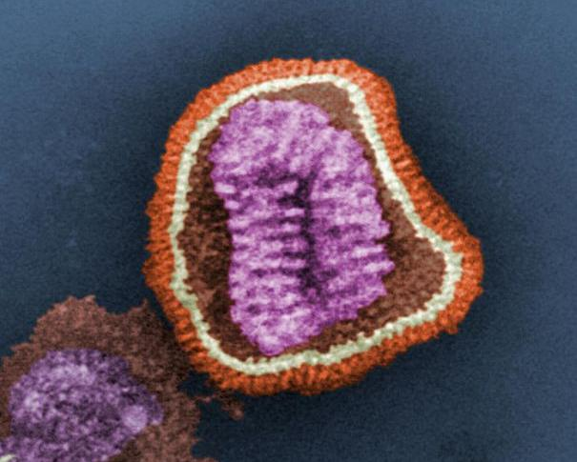
Decoding the Flu
Norris Armstrong
University of Georgia
Image Source: http://commons.wikimedia.org/wiki/File:Influenza_virus_particle_color.jpg
1

Slide 2
Jason was worried. He had landed a summer internship at the National Center for Preparedness, Detection, and Control of Infectious Diseases (NCPDCID). It didn’t pay, but it helped boost his resume before applying to medical school. His boss also let him tag along on a CDC research trip to rural Mexico. However, what had appeared to be a wonderful opportunity didn’t seem so great when the team contracted one of the flu viruses they had been studying. So far, he was the only one other than the team leader, Dr. Phillips, who was not sick.
Earlier that morning, Dr. Phillips told Jason she had a job for him. “Normally, I would give this to a senior staffer, but they’re all sick. We think there may be a problem with the flu virus the team has caught. Here’s some background. I’ll be right back with your assignment.”
2

Slide 3
Flu Fact Sheet
You may find the information in the handout on influenza useful as we go through this case study.
3

Slide 4
Dr. Phillips came back a few minutes later. “Here is the situation. The team appears to have contracted an atypical flu virus. For starters, the symptoms are worse than usual and even healthy adults are getting severely ill. Also, none of the team’s vaccinations protected them from this virus. We’re worried that we are dealing with a new strain of influenza we haven’t seen before. We need to figure out how this virus is different.”
4

Slide 5
“The hemagglutinin (HA) protein helps the flu virus infect cells and the structure of this protein can vary in different virus strains. I want you to compare the HA gene for the viruses the team was examining with a typical flu virus. Because we don’t have power right now, you will have to do this the old-fashioned way with pencil and paper. I will get you the nucleotide sequence for a typical HA gene. You can start by finding the coding region for the gene.”
Dr. Phillips left the tent. “Wait!” Jason called after her. “How do I do that!” It was too late; she was already gone. Jason hadn’t thought about DNA and proteins since intro biology. He pulled the biology textbook he had brought with him to prepare for the MCATs out of his backpack. He had better relearn how DNA is used to make proteins, and quickly.
5

Slide 6
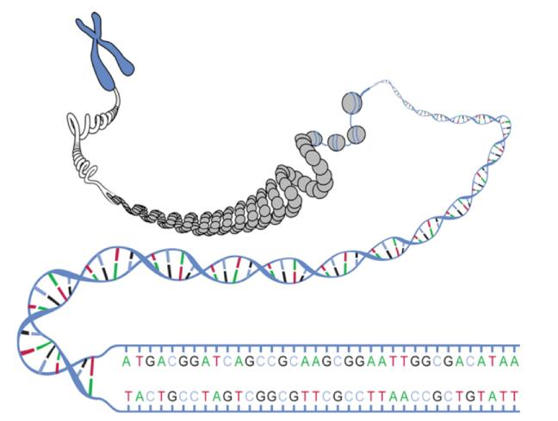
Human chromosomes: 50->250 million base pairs.
Average gene: 3000 base pairs.
<5% of DNA codes for protein.
How to find the genes?.
Source: http://commons.wikimedia.org/wiki/Image:DNA_ORF.gif
6

Slide 7
What is a Gene?
Short stretch of DNA on chromosome.
Two parts:
Regulatory
region
Coding
region
DNA
Information in genes used to make proteins.
Two stages:
Transcription
Translation
7

Slide 8
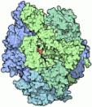

Transcription
Regulatory region has a binding site for RNA polymerase.
RNA Polymerase
Promoter
Terminator
Gene Coding Region
copy of coding region
messenger RNA (mRNA)
DNA: http://commons.wikimedia.org/wiki/File:Helix84.JPG
RNA Polymerase: http://commons.wikimedia.org/wiki/File:PDB_1sfo_EBI.jpg
RNA: http://commons.wikimedia.org/wiki/File:Simple_transcription_termination1.svg
8

Slide 9
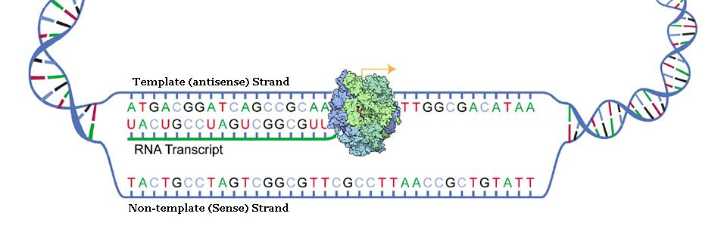
Transcription
Similar to DNA replication, but different.
Copies only one of the two strands.
Makes a copy as RNA, not DNA.
Transcription: http://www.dnai.org/a/index.html and http://www.stolaf.edu/people/giannini/flashanimat/molgenetics/transcription.swf
Source: http://commons.wikimedia.org/wiki/File:DNA_transcription.svg
9

Slide 10
3’-ATCGGCAGGACCTTAAAT-5’
5’-TAGCCGTCCTGGAATTTA-3’
CQ#1: If the DNA molecule above were transcribed, which of the following RNAs might be produced?
3′-ATCGGCAGGACCTTAAAT-5′
5′-TAGCCGTCCTGGAATTTA-3′
3′-AUCGGCAGGACCUUAAAU-5′
5′-UAGCCGUCCUGGAAUUUA-3′
Both A and B
Both C and D
All of the above
None of the above
10

Slide 11
Transcription
RNA
5’-UAGCCGUCCUGGAAUUUA-3’
3’-ATCGGCAGGACCTTAAAT-5’
5’-TAGCCGTCCTGGAATTTA-3’
DNA
RNA
3’-AUCGGCAGGACCUUAAAU-5’
11

Slide 12
Translation
DNA/RNA
Protein
Adenine
Cytosine
Guanine
Thymine/Uracil
Alanine Arginine
Asparagine Aspartate Cysteine Glutamine
Glutamate Glycine
Histidine Isoleucine
Leucine Lysine
Methionine Phenylalanine
Proline Serine
Threonine Tyrosine
Tryptophan Valine
12
Notes:
12

Slide 13
CQ#2: If a combination of two nucleotides corresponded to an amino acid, how many different amino acids could DNA code for?
2
4
8
16
32
13

Slide 14
One-letter code
Two-letter code
A
G
C
T/U
AA CA GA UA
AG CG GG UG
AC CC GC UC
AU CU GU UU
14
14

Slide 15
Bases in DNA/RNA form triplet code
Codon Table:
 |  | Second Base
 |  | U |  | C |  | A |  | G
First base | U | UUU | Phe (F) | UCU | Ser (S) | UAU | Tyr (Y) | UGU | Cys (C) | U | Third base
 |  | UUC |  | UCC |  | UAC |  | UGC |  | C
 |  | UUA | Leu (L) | UCA |  | UAA | Stop | UGA | Stop | A
 |  | UUG |  | UCG |  | UAG | Stop | UGG | Trp (W) | G
 | C | CUU | Leu (L) | CCU | Pro (P) | CAU | His (H) | CGU | Arg (R) | U
 |  | CUC |  | CCC |  | CAC |  | CGC |  | C
 |  | CUA |  | CCA |  | CAA | Gln (Q) | CGA |  | A
 |  | CUG |  | CCG |  | CAG |  | CGG |  | G
 | A | AUU | Ile (I) | ACU | Thr (T) | AAU | Asn (N) | AGU | Ser (S) | U
 |  | AUC |  | ACC |  | AAC |  | AGC |  | C
 |  | AUA |  | ACA |  | AAA | Lys (K) | AGA | Arg (R) | A
 |  | AUG | Met (M) | ACG |  | AAG |  | AGG |  | G
 | G | GUU | Val (V) | GCU | Ala (A) | GAU | Asp (D) | GGU | Gly (G) | U
 |  | GUC |  | GCC |  | GAC |  | GGC |  | C
 |  | GUA |  | GCA |  | GAA | Glu (E) | GGA |  | A
 |  | GUG |  | GCG |  | GAG |  | GGG |  | G
15

Slide 16
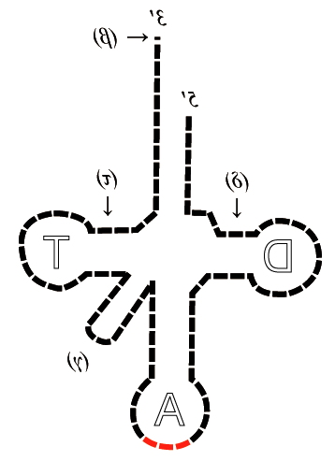
Translation
Messenger RNA (mRNA) carries the nucleotide code for the protein to be made.
Amino Acid
Transfer RNA (tRNA) molecules “interpret” the nucleotide code.
5′
Each tRNA carries an amino acid and an anticodon complementary to a codon in the mRNA.
tRNA
anticodon
ACG
codon
UGC
5′
3′
mRNA
Source: http://commons.wikimedia.org/wiki/File:Schema_ARNt_448_658.png
16

Slide 17
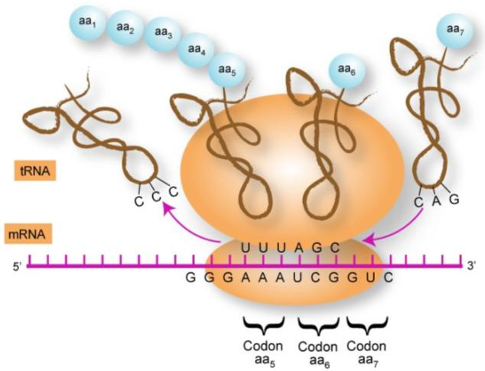
Translation
Ribosomes use tRNA to “read” messenger RNA and assemble the amino acids they carry into a new protein.
DNA-Interactive: http://www.dnai.org/a/index.htmlDNA-Interactive: http://www.dnai.org/a/index.html or http://www.stolaf.edu/people/giannini/flashanimat/molgenetics/translation.swf
Source: http://commons.wikimedia.org/wiki/File:Proteintransl.jpg
17

Slide 18
5’CACGGUCGAUGAGGUUACAUCGC… 3’
CQ#3: Part of an mRNA molecule is shown above. If this fragment came from the beginning of the mRNA, for which of the amino acid sequences below would it most likely code?
His-Gly-Arg
Thr-Val-Asp-Glu-Val-Thr
Met-Arg-Leu-His-Arg
Gln-Tyr-Ile-Gly-Val-Ala-Gly
18

Slide 19
csadaksjdfllasdailsdflRaiseyourhandifyoucanreadthis.aksdjfjasdkjaskklasdjfkkjajdfiodlskj
19

Slide 20
csadaksjdfllasdailsdflRaiseyourhandifyoucanreadthis.aksdjfjasdkjaskklasdjfkkjajdfiodlskj
Not all of mNRA molecule codes for protein.
Need punctuation to identify where coding region begins and ends:
  -Start
  -Stop
20

Slide 21
Bases in DNA/RNA form triplet code
Codon Table:
 |  | Second Base
 |  | U |  | C |  | A |  | G
First base | U | UUU | Phe (F) | UCU | Ser (S) | UAU | Tyr (Y) | UGU | Cys (C) | U | Third base
 |  | UUC |  | UCC |  | UAC |  | UGC |  | C
 |  | UUA | Leu (L) | UCA |  | UAA | Stop | UGA | Stop | A
 |  | UUG |  | UCG |  | UAG | Stop | UGG | Trp (W) | G
 | C | CUU | Leu (L) | CCU | Pro (P) | CAU | His (H) | CGU | Arg (R) | U
 |  | CUC |  | CCC |  | CAC |  | CGC |  | C
 |  | CUA |  | CCA |  | CAA | Gln (Q) | CGA |  | A
 |  | CUG |  | CCG |  | CAG |  | CGG |  | G
 | A | AUU | Ile (I) | ACU | Thr (T) | AAU | Asn (N) | AGU | Ser (S) | U
 |  | AUC |  | ACC |  | AAC |  | AGC |  | C
 |  | AUA |  | ACA |  | AAA | Lys (K) | AGA | Arg (R) | A
 |  | AUG | Met (M) Start | ACG |  | AAG |  | AGG |  | G
 | G | GUU | Val (V) | GCU | Ala (A) | GAU | Asp (D) | GGU | Gly (G) | U
 |  | GUC |  | GCC |  | GAC |  | GGC |  | C
 |  | GUA |  | GCA |  | GAA | Glu (E) | GGA |  | A
 |  | GUG |  | GCG |  | GAG |  | GGG |  | G
21

Slide 22
5’CACGGUCGAUGAGGUUACAUCGC… 3’
CQ#4: Part of an mRNA molecule is shown above. If this fragment came from the beginning of the mRNA, for which of the amino acid sequences below would it most likely code?
His-Gly-Arg
Thr-Val-Asp-Glu-Val-Thr
Met-Arg-Leu-His-Arg
Gln-Tyr-Ile-Gly-Val-Ala-Gly
22

Slide 23
Reading Frames
5’CACGGUCGAUGAGGUUACAUAAC… 3’
Reading frame-1
5’CAC GGU CGA UGA GGU UAC AUA AC… 3’
Reading frame-2
5’C ACG GUC GAU GAG GUU ACA UAA C… 3’
Reading frame-3
5’CA CGG UCG AUG AGG UUA CAU AAC… 3’
23

Slide 24
Reading Frames
5’CACGGUCGAUGAGGUUACAUAAC… 3’
Reading frame-1
5’CAC GGU CGA UGA GGU UAC AUA AC… 3’
His Gly Arg STOP
Reading frame-2
5’C ACG GUC GAU GAG GUU ACA UAA C… 3’
Thr Leu His Glu Val Thr STOP
Reading frame-3
5’CA CGG UCG AUG AGG UUA CAU AAC… 3’
Met Arg Leu His Thr…
24

Slide 25
Dr. Phillips returned with a sheet of paper. “Without computers, all I have been able to find so far is a partial sequence I believe is at the beginning of the HA gene.* I also have the start of the HA protein sequence. See if you can find the coding region while I look for more info.”
DNA Sequence
3’CTTACATCGAGTTTCGTTACTATCAGAAGTACCAAT 5’
5’GAATGTAGCTCAAAGCAATGATAGTCTTCATGGTTA 3’
HA amino acid sequence
Met Lys Thr Ile Ile Ala Leu Ser Tyr Ile…
25

Slide 26
RNA#1
5’GAAUGUAGCUCAAAGCAAUGAUAGUCUUCAUGGUUA 3’
3’CTTACATCGAGTTTCGTTACTATCAGAAGTACCAAT 5’
5’GAATGTAGCTCAAAGCAATGATAGTCTTCATGGTTA 3’
DNA
RNA#2
3’CUUACAUCGAGUUUCGUUACUAUCAGAAGUACCAAU 5’
26

Slide 27
RNA#1
5’GAAUGUAGCUCAAAGCAAUGAUAGUCUUCAUGGUUA 3’
3’CTTACATCGAGTTTCGTTACTATCAGAAGTACCAAT 5’
5’GAATGTAGCTCAAAGCAATGATAGTCTTCATGGTTA 3’
DNA
RNA#2
3’CUUACAUCGAGUUUCGUUACUAUCAGAAGUACCAAU 5’
RNA#2
5’UAACCAUGAAGACUAUCAUUGCUUUGAGCUACAUUC 3’
27

Slide 28
RNA#1
5’GAAUGUAGCUCAAAGCAAUGAUAGUCUUCAUGGUUA 3’
Reading frame-1
GAA UGU AGC UCA AAG CAA UGA UAG UCU UCA UGG UUA
Reading frame-2
G AAU GUA GCU CAA AGC AAU GAU AGU CUU CAU GGU UA
Reading frame-3
GA AUG UAG CUC AAA GCA AUG AUA GUC UUC AUG GUU A
RNA#2
5’UAACCAUGAAGACUAUCAUUGCUUUGAGCUACAUUC 3’
Reading frame-1
UAA CCA UGA AGA CUA UCA UUG CUU UGA GCU ACA UUC
Reading frame-2
U AAC CAU GAA GAC UAU CAU UGC UUU GAG CUA CAU UC
Reading frame-3
UA ACC AUG AAG ACU AUC AUU GCU UUG AGC UAC AUU C
28

Slide 29
RNA#1
5’GAAUGUAGCUCAAAGCAAUGAUAGUCUUCAUGGUUA 3’
Reading frame-1
GAA UGU AGC UCA AAG CAA UGA UAG UCU UCA UGG UUA
Reading frame-2
G AAU GUA GCU CAA AGC AAU GAU AGU CUU CAU GGU UA
Reading frame-3
GA AUG UAG CUC AAA GCA AUG AUA GUC UUC AUG GUU A
RNA#2
5’UAACCAUGAAGACUAUCAUUGCUUUGAGCUACAUUC 3’
Reading frame-1
UAA CCA UGA AGA CUA UCA UUG CUU UGA GCU ACA UUC
Reading frame-2
U AAC CAU GAA GAC UAU CAU UGC UUU GAG CUA CAU UC
Reading frame-3
UA ACC AUG AAG ACU AUC AUU GCU UUG AGC UAC AUU C
29

Slide 30
RNA#1
5’GAAUGUAGCUCAAAGCAAUGAUAGUCUUCAUGGUUA 3’
Reading frame-1
GAA UGU AGC UCA AAG CAA UGA UAG UCU UCA UGG UUA
Reading frame-2
G AAU GUA GCU CAA AGC AAU GAU AGU CUU CAU GGU UA
Reading frame-3
GA AUG UAG CUC AAA GCA AUG AUA GUC UUC AUG GUU A
Met STOP Met Ile Val Phe Met Val
RNA#2
5’UAACCAUGAAGACUAUCAUUGCUUUGAGCUACAUUC 3’
Reading frame-1
UAA CCA UGA AGA CUA UCA UUG CUU UGA GCU ACA UUC
Reading frame-2
U AAC CAU GAA GAC UAU CAU UGC UUU GAG CUA CAU UC
Reading frame-3
UA ACC AUG AAG ACU AUC AUU GCU UUG AGC UAC AUU C
Met Lys Thr Ile Ile Ala Leu Ser Tyr Ile
30

Slide 31
“Great! You found the start for the HA gene coding region. Here are HA genes data the team had collected for the flu strains that they were studying. We only have information on the start of the gene, but it might be enough.”
The virus that the team has contracted probably had a mutation that results in a different but still functional version of the HA gene. See if one of the viruses the team was examining would fit this description.
31

Slide 32
Typical HA RNA
5’UAACCAUGAAGACUAUCAUUGCUUUGAGCUACAUUC 3’
Strain #1 RNA
5’UAACCAUGAGGACUAUCAUUGCUUUGAGCUACAUUC 3’
CQ#5: How is the HA protein produced by the new flu virus different from a typical flu virus?
There is no difference.
One amino acid has been changed.
Several amino acids have been changed.
The protein is too short.
The protein is too long.
32

Slide 33
Typical HA RNA
5’UAACCAUGAAGACUAUCAUUGCUUUGAGCUACAUUC 3
Lys
Strain #1 RNA
5’UAACCAUGAGGACUAUCAUUGCUUUGAGCUACAUUC 3’
Arg
Mis-Sense (substitution) Mutation
33

Slide 34
Typical HA RNA
5’UAACCAUGAAGACUAUCAUUGCUUUGAGCUACAUUC 3
Strain #2 RNA
5’UAACCAUGAAGACUAUCAUUGCUUAGAGCUACAUUC 3’
CQ#6: How is the HA protein produced by the new flu virus different from a typical flu virus?
There is no difference.
One amino acid has been changed.
Several amino acids have been changed.
The protein is too short.
The protein is too long.
34

Slide 35
Typical HA RNA
5’UAACCAUGAAGACUAUCAUUGCUUUGAGCUACAUUC 3
Leu
Strain #2 RNA
5’UAACCAUGAAGACUAUCAUUGCUUAGAGCUACAUUC 3’
Stop
Non-Sense Mutation (truncation)
35

Slide 36
Typical HA RNA
5’UAACCAUGAAGACUAUCAUUGCUUUGAGCUACAUUC 3
Strain #3 RNA
5’UAACCAUGAAGACCAUCAUUGCUUUGAGCUACAUUC 3’
CQ#7: How is the HA protein produced by the new flu virus different from a typical flu virus?
There is no difference.
One amino acid has been changed.
Several amino acids have been changed.
The protein is too short.
The protein is too long.
36

Slide 37
Typical HA RNA
5’UAACCAUGAAGACUAUCAUUGCUUUGAGCUACAUUC 3
Thr
Strain #3 RNA
5’UAACCAUGAAGACCAUCAUUGCUUUGAGCUACAUUC 3’
Thr
Silent Mutation
37

Slide 38
Typical HA RNA
5’UAACCAUGAAGACUAUCAUUGCUUUGAGCUACAUUC 3
Strain #4 RNA
5’UAACCAUGAAGACAUCAUUGCUUUGAGCUACAUUC 3’
CQ#8: How is the HA protein produced by the new flu virus different from a typical flu virus?
There is no difference.
One amino acid has been changed.
Several amino acids have been changed.
The protein is too short.
The protein is too long.
38

Slide 39
Typical HA RNA
5’UAACCAUGAAGACUAUCAUUGCUUUGAGCUACAUUC 3
Met Lys Thr Ile Ile Ala Leu Ser Tyr Ile
Strain #4 RNA
5’UAACCAUGAAGACAUCAUUGCUUUGAGCUACAUUC 3’
Met Lys Thr Ser Leu Leu STOP
Frame Shift Mutation
39
Notes:
39
Image by Cynthia Goldsmith, obtained from Wikipedia Commons: http://commons.wikimedia.org/wiki/File:Influenza_virus_particle_color.jpg. This media originally comes from the Centers for Disease Control and PreventionImage by Cynthia Goldsmith, obtained from Wikipedia Commons: http://commons.wikimedia.org/wiki/File:Influenza_virus_particle_color.jpg. This media originally comes from the Centers for Disease Control and Prevention's Public Health Image Library (PHIL), with identification number #10073. Public domain.

Slide 40
CQ#9: Based on the information you have, which of the four strains is most likely to be the one causing the illness?
Strain #1
Strain #2
Strain #3
Strain #4
40

Slide 41
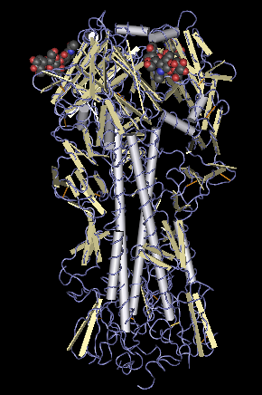
Hemagglutinin protein
Source: http://commons.wikimedia.org/wiki/File:Hemagglutinin_molecule.png
41

Slide 42
“Good job, Jason,” Dr. Phillips commented as she headed out to the truck that would carry her and the samples to the airport. “This will hopefully give the lab back home a head start investigating this new strain of flu. I’ll be back in a couple of hours. The team’s condition seems to be getting better so I don’t think you will have much trouble while I am gone. Give them plenty of fluids and remember to wash your hands frequently to help keep you from catching this bug. It doesn’t appear to be as bad as we feared but it is still pretty nasty.”
42

